Slide 1
Azure Data Explorer
Arun Prakasam

Slide 2
Cloud Scale Analytics - Common customer patterns
Modern data warehousing
Real-time analytics
Machine Learning
"We want to analyze data coming from multiple sources and in varied formats"
“We’re trying to get insights from our devices in real-time”
"We want to leverage the analytics platform for advanced fraud detection"

Slide 3




Azure powered pattern for real-time analytics
Ingest
Analyze
Apps and analytics
Streaming Data
Continuous/ Streaming real-time analytics
Logs, Files, Media
IoT Hub
Alerts and actions
Real-time apps
Real-time dashboards
On-demand dashboards
Data warehousing
Batch and ML training
Storage / archival
Azure Stream Analytics
Customer sentiment data
On-demand/ Interactive
real-time analytics
Weather data
Event Hubs
Azure Data Explorer
Business Applications
Notes:
© Microsoft Corporation

Slide 4
Azure Data Explorer
Azure Data Explorer is a fast, fully managed data analytics service for real-time analysis on large volumes of data streaming from applications, websites, IoT devices, and more
Azure Data Explorer to collect, store, and analyze diverse data to improve products, enhance customer experiences, monitor devices, and boost operations.
Handling of large amount of structured , semi-structured ( JSON –like nested types) and unstructured ( free-text) data equally well
Notes:
© Microsoft Corporation

Slide 5
Azure Data Explorer Interactive analytics service for fast flowing data
Cuts down time-to-insight
Get real-time insights from fast-flowing data
Fully managed
Autoscale and maintenance free indexing
Enables data-driven culture
Proven intuitive and easy to use query language
Notes:
© Microsoft Corporation

Slide 6
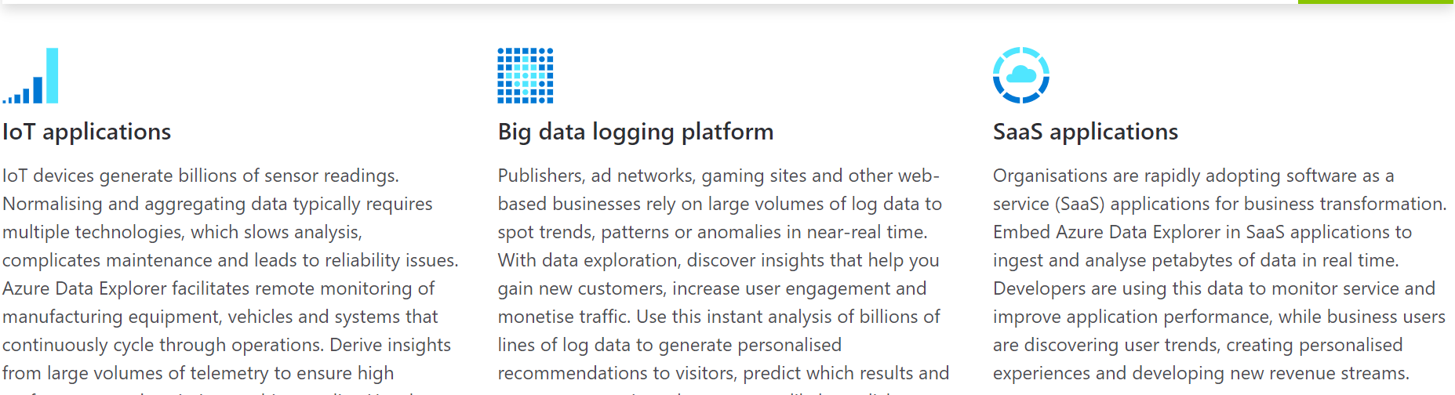
Use Cases

Slide 7
Kusto Query Language
A Kusto query is a read-only request to process data and return results
Syntax : Has tabular data flow from one tabular query operator to another, starting with data source (e.g. a table in a database, or an operator that produces data) and then flowing through a set of data transformation operators that are bound together through the use of the pipe (|) delimiter.
Eg :
StormEvents | where StartTime >= datetime(2007-11-01) and StartTime < datetime(2007-12-01) | where State == "FLORIDA" | count

Slide 8
Schema Mapping in Kusto
CSV Mapping
Ordinal Based Mapping
JSON / AVRO Mapping
Path or Field Name based mapping

Slide 9
Kusto Query Language – Practice Platforms
Log Analytics
https://aka.ms//LADemo
Application Insights
Https://aka.ms/AIAnalyticsDemo
Advanced Thread Protection
https://aka.ms/WinDefATP

Slide 10
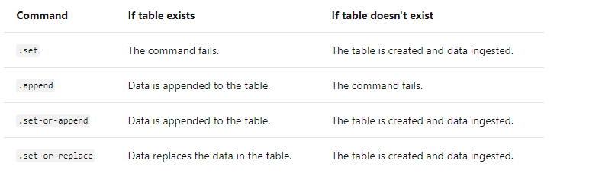
Ingest data from a query

Slide 11
Data Ingestion with Event Hubs
Event Hubs are big data pipelines
Supports multiple concurrent sources
Make events available to a variety of
services
Receive and process millions of events per second

Slide 12
Data Ingestion with Event Grid
Event-driven
Enables reactive programming
Can be integrated with third-party services
Dynamically scalable and low cost

Slide 13
Azure Data Share
Easily share data the way you want
Share data, in any format and any size, from multiple sources with other organizations.
There is no infrastructure to set up or manage
No SAS keys are required and sharing is all code-free

Slide 14
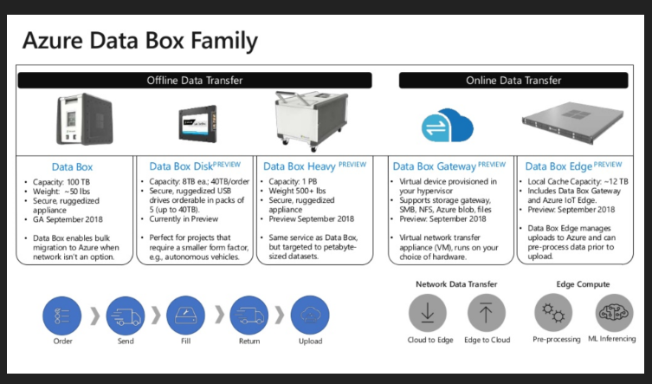
Azure Data Box

Slide 15
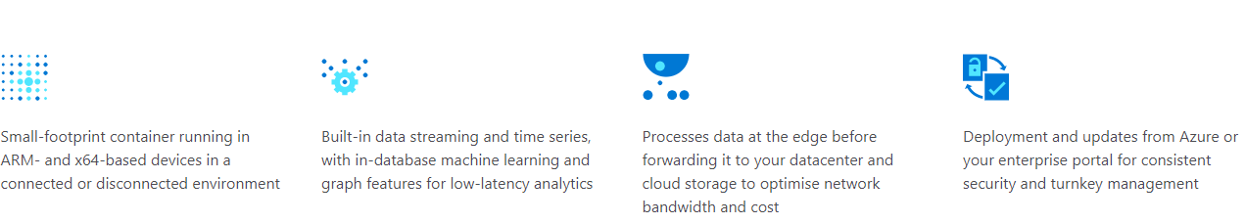
Azure SQL Edge Database.

